Slide 1
Employee’s information system
-Kelompok BlackHole-
Fila Brilyanti Utami
Astrid Rifa
Aafiudin
Amanda Putri Septiani

Slide 2
problem
Difficult to manage employee’s data in the company with the manual way
Difficult to manage employee’s salary according to the employee’s class
Difficult to manage employee’s daily presence

Slide 3
Feasibility and planning
Client : Company
Scope : Human Resource Information System
Advantages : Easy to manage, Decrease the risk of missing data and error, Make it easier for counting employee’s salary
Resource : 4 people in our team
Timetable :
September : Fullfill the requirement, planning, the basic of software programming
October - November : Start to implementation (coding)
December : Testing the software and do the revision if needed

Slide 4
Feasibility and planning
Risks :
Take a long time because the number of developer
Difficult to make error handling
Need the expert to run the program in the company
Alternative :
Use the timetable
Give a simple training to the operator in the company (client)

Slide 5
System requirements
System Requirements
Process-Oriented :
- System can add new employee
- System can detect the input from user
Information-Oriented :
- System has employee data
Operational :
- System should be operated using in all web browser
- System is easy to use.

Slide 6
System requirements
Performance :
- The system has the ability to store data
- System responds in + 0.5 second
Security :
- Only users who are logged in can be absent
- Only Secretary who can recapitalize absent

Slide 7
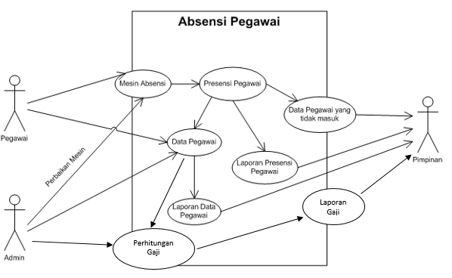
Use case diagram

Slide 8
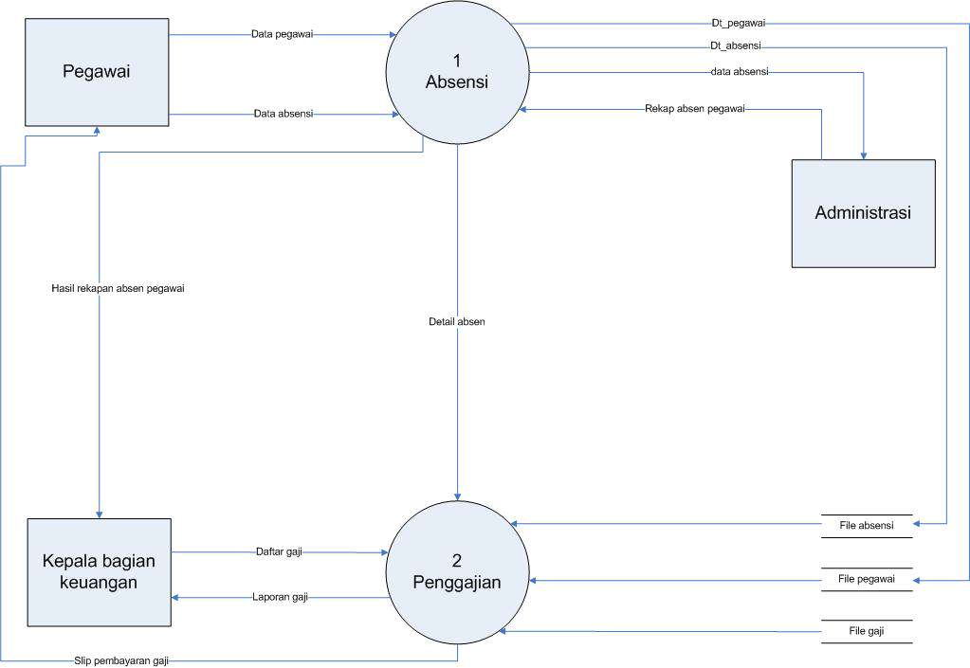
DFD

Slide 9
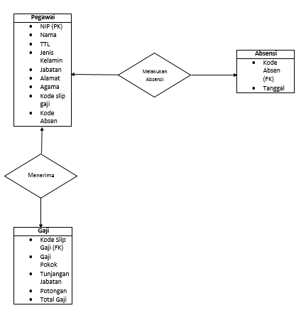
ERD

Slide 10
THANK you

